Slide 1
Wonderful future of programming
Language edition

Slide 2
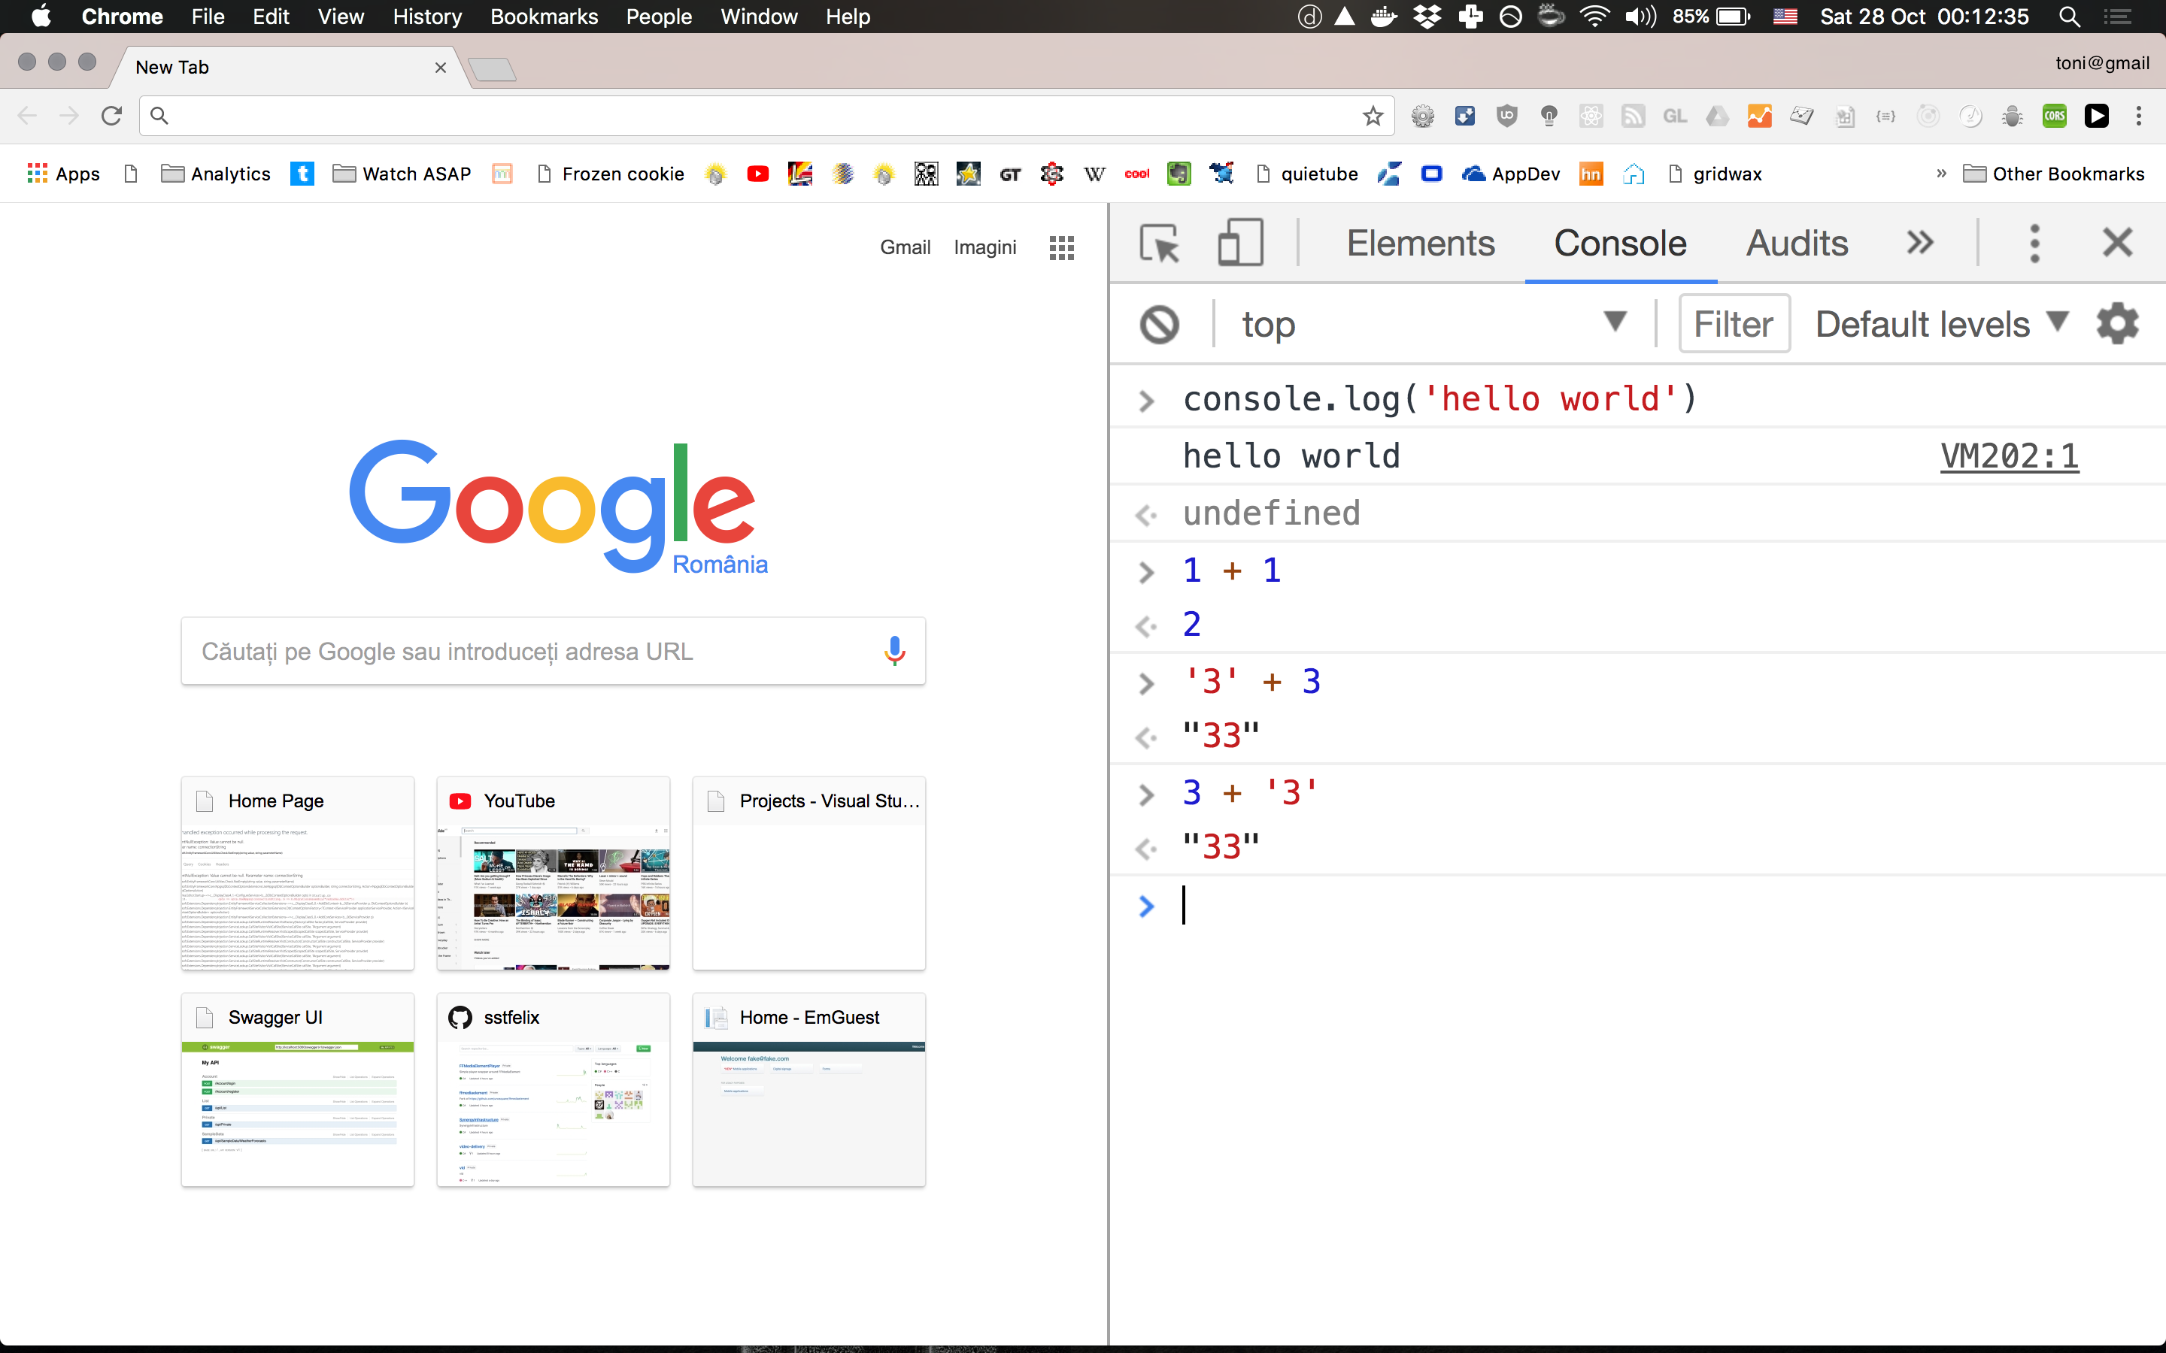

Slide 3
New languages
Rust
Elm
Elixir
Clojure
Julia
Kotlin
ECMAScript6 aka JavaScript 2015
ECMAScript7 aka JavaScript 2016
ECMAScript8 aka JavaScript 2017

Slide 4
Will use JavaScript anyway, LOL

Slide 5
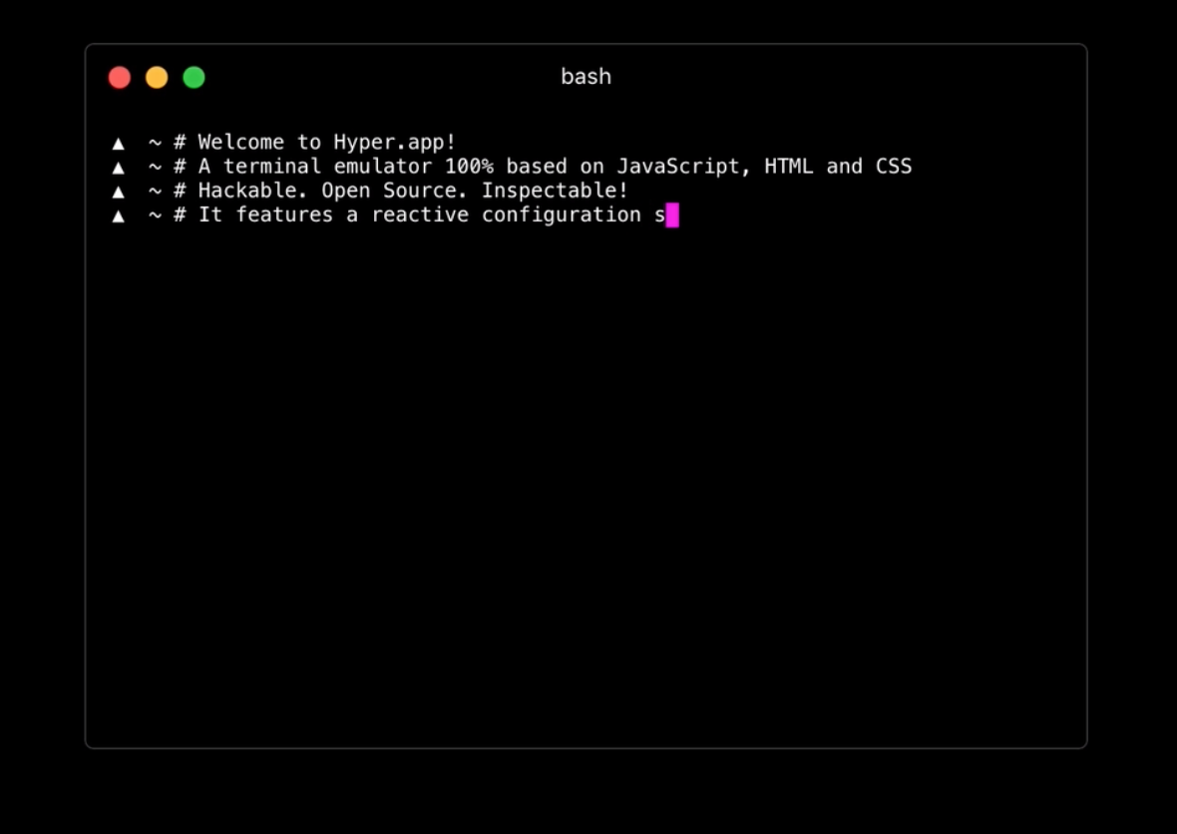
Or write terminal in JavaScript
http://hyper.is

Slide 6
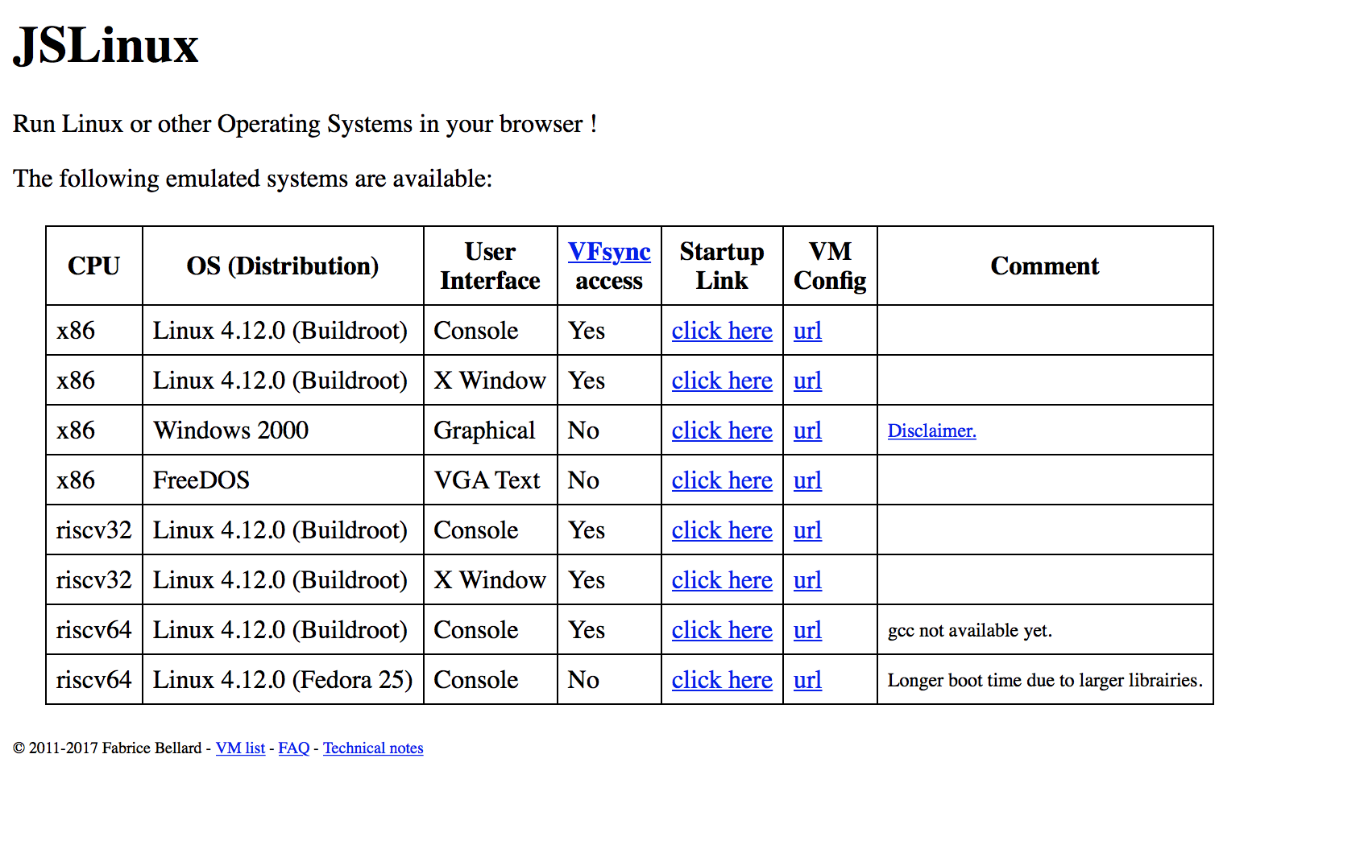
https://bellard.org/jslinux/

Slide 7
HTML inside JavaScript???
class Component extends React.Component {
render() {
return <div className="container">
<h1 style={{fontWeight: 'bold'}}>Title?</h1>
</div>
}
}
CSS inside Javascript???

Slide 8

Web – Angular, React, Vue, Om
Mobile: Ionic, React Native
Database: MongoDB, RethinkDB
Desktop: Electron
https://www.programmableweb.com/news/why-node.js-ideal-internet-things/analysis/2014/07/31

Slide 9
You can learn all that new stuff…

Slide 10
…or just learn javascript

